Slide 1
Data Analysis Project
Updated : 31/05/2026
XYZ Sports Sales Marketing Analysis
Project Presentation
Presented By :
Yosafat

Slide 2

Updated : 31/05/2026
List of Contents
01
Introduction
02
Problem Statement & Business Objective
03
Data Overview

Slide 3



Introduction
Updated : 31/05/2026
Background : XYZ Sport is a company focused on the sporting goods industry, founded in 2018. Their vision is to become the best-quality brand in the world of sports by providing high-quality equipment for sports enthusiasts in Indonesia.
Target Market & Marketing Strategy : XYZ Sport uses a multichannel marketing strategy to reach its customers. In addition to distributing sales through various retailers and distributors. The company maintains a strong online presence through social media and participates in various sponsorships and sporting events. Therefore, the company works with marketing agents such as online resellers and dropshippers.

Slide 4
Updated : 31/05/2026
Problem Statement &
Business Objective
Problem Statement : Between 2020 until 2022, the company experienced a stagnation in sales revenue and a persistent, year-over-year decline.
So the executive and stakeholders
need breakdown and deep insight about the sales
performance. Without identifying the root causes
of the shrinking transaction sizes and regional
performance gaps, the company cannot effectively
allocate its marketing resources, optimize
inventory, or adjust its sales strategies to drive profitable growth.
Objective 1 : Analyze Sales product related to Average Order Value (AOV)
Objective 2 : Evaluate Regional and Sales Team Performance to Maximize
Objective 3 : Analyze Partner Store Behavior to Drive High-Value B2B Transactions
Goal: Understand purchasing patterns among B2B retail and distributor partners to encourage larger bulk orders.
Goal: Determine how different product categories, unit prices, and discount strategies are influencing the overall transaction size.
Goal: Assess th^{R}e^{ev}e^{e}ffe^{n}c^{u}tiv^{e}eness of sales
operations across regions and sales teams.
Focus: Pinpoint high-performing and
Focus: Identify which specific
revenue
product versus
underperforming regions. Analyze which sales promotion methods yield the highest return on
Focus: stores
Identify based
the most valuable partner on their total revenue
categories drive the most
investment to help reallocate resources effectively.
contribution and order frequency.
those that lower the AOV.

Slide 5
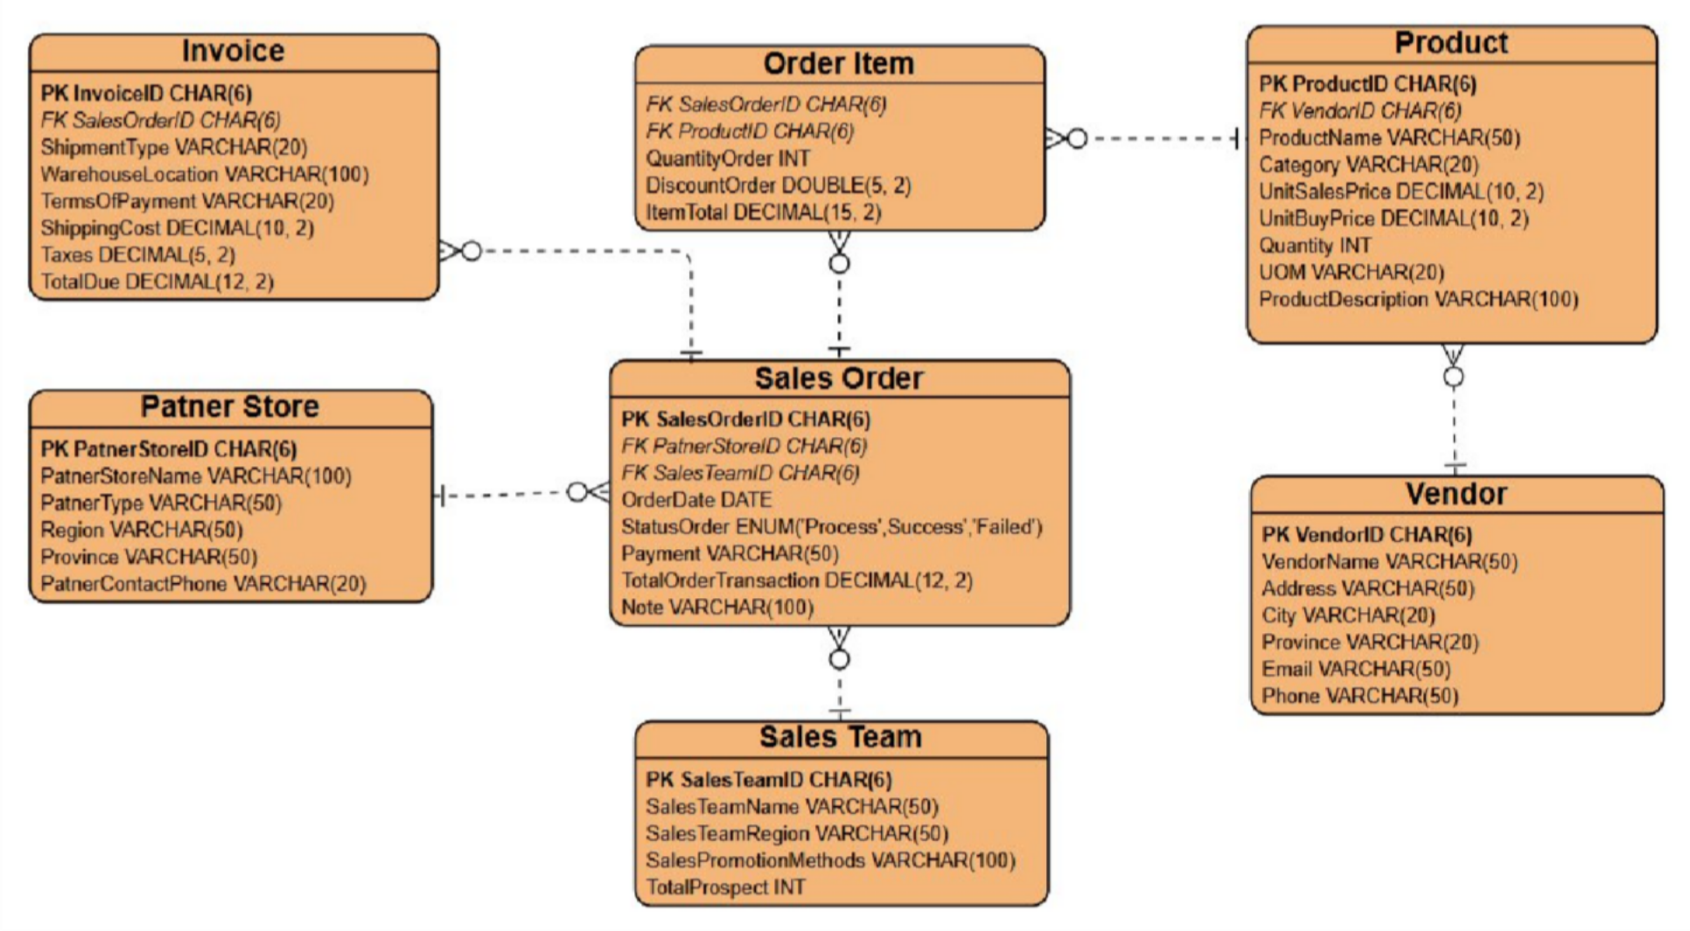
Data Overview
Updated : 31/05/2026
Core Transactions: The database is centralized around the Sales Order table(using star schema), which records the transaction details and links directly to Order Items (specific products and quantities sold) and Invoices (billing, taxes, and shipping logistics).
Stakeholders: The model tracks the key players involved in every sale by linking the transaction to the Patner Store (the B2B customers buying the goods) and the internal Sales Team (the staff managing the region and account).
Inventory & Supply: The physical goods are managed through the Product table, which tracks stock levels, categories, and pricing. This is directly linked to the Vendor table to monitor the external suppliers providing those items.

Slide 6
Updated : 31/05/2026
Thank You
Presented By :
Yosafat

